Slide 1
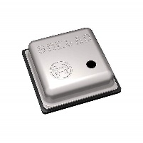
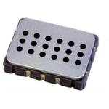
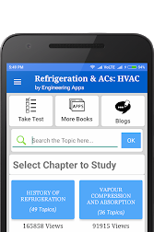
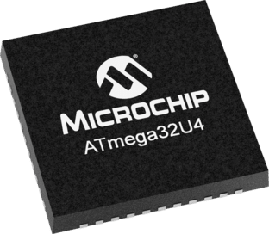



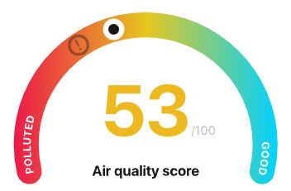





BLOCK DIAGRAM
Purpose: Design of readout electronic circuitry for sensors to detect 3M Novec 71DE, 3M Novec 7100, and CFC-113
Sensor
Controller
User
Controlling Sensors and Bluetooth
Data analyzing
Detecting Gas
BME680
MICS-6814
ATmega32u4
Bluetooth
Pressure
Temperature
Humidity
Gas
Gas
3M Novec 71DE
3M Novec 7100
CFC-113
Bluetooth Low Energy communication
Real time data display App using Bluetooth
Alarm for hazardous gas level
SPBTLE-1S

Slide 2
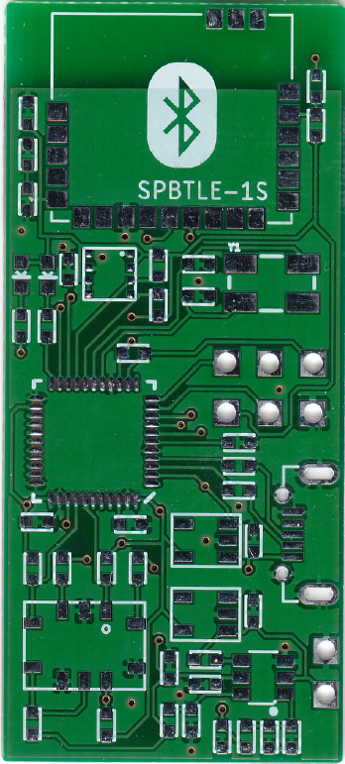
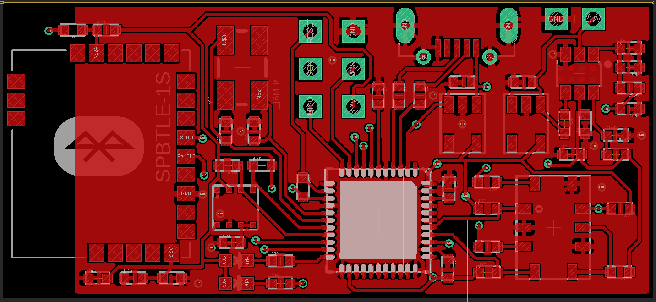
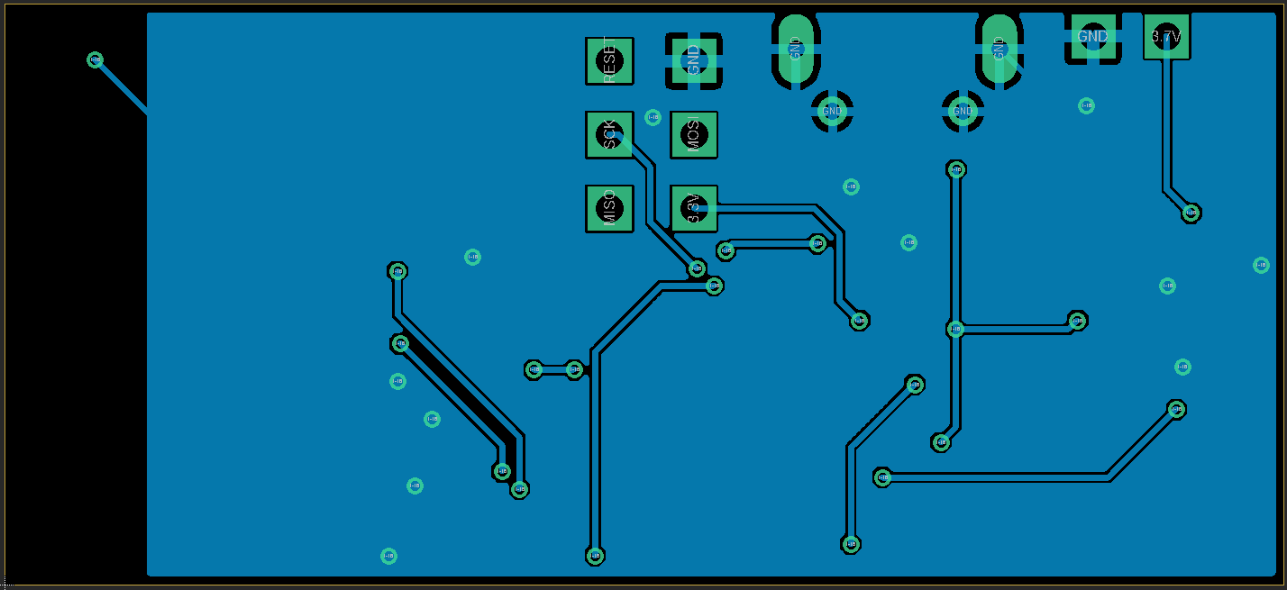
Pcb design version1
Layout
45 mm
PCB
20 mm
1st Layer
Bluetooth (SPBTLE-1S)
MCU (ATmega32u4)
Sensor1 (BME680)
Sensor2 (MICS-6814)
2nd Layer

Slide 3
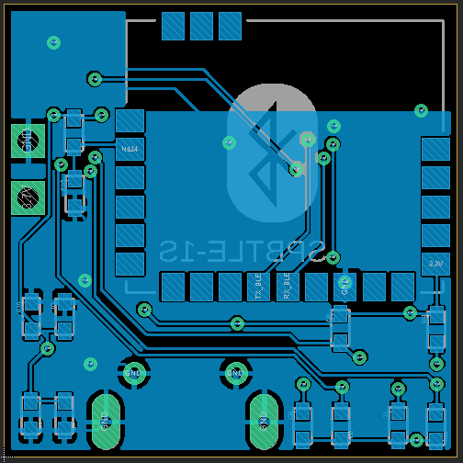
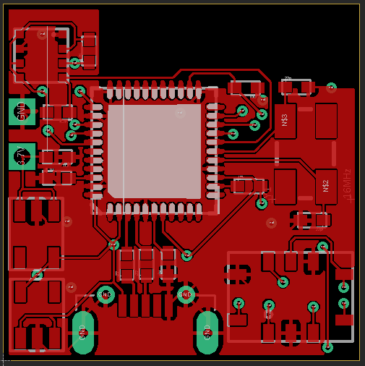
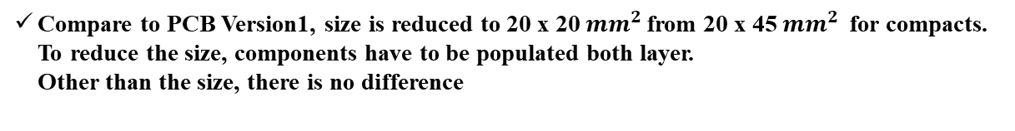
Pcb design version2
Layout
20 mm
20 mm
1st Layer
2nd Layer
Compare to PCB Version1, size is reduced to 20 x 20 ${mm}^{2 }$from 20 x 45 ${mm}^{2 }$ for compacts. To reduce the size, components have to be populated both layer. Other than the size, there is no difference

Slide 4
Summary and future works
Summary
Design of readout electronic circuitry for sensors to detect 3M Novec 71DE, 3M Novec 7100, and CFC-113 is presented
BME680(@Bosche), MICS-6814(@SGXSENSORTECH) is selected as sensor to detect the target gases
ATmega32u4(@Atmel) and SPBTLE-1S(@STMicroelectronics) is selected to control the sensors and send the data to the users
Future Works
Populating components on the PCB
Develop the android app to display the sensor output and set up the alarm for certain level of gases
Test the PCB with target gases

